Slide 1

NAME OF THE COURSE
MADSC202 DEEP LEARNING AND AI
NAME OF THE FACULTY
Dr. ATHANSIOS RIZOS
NAME OF THE STUDENTS
KUMAR GAURAV – 22026384
TITLE OF ASSIGNMENT
MID TERM ASSIGNMENT

Slide 2

USAGE OF DEEP LEARNING IN CRIME PREVENTION AND CYBER SECURITY

Slide 3
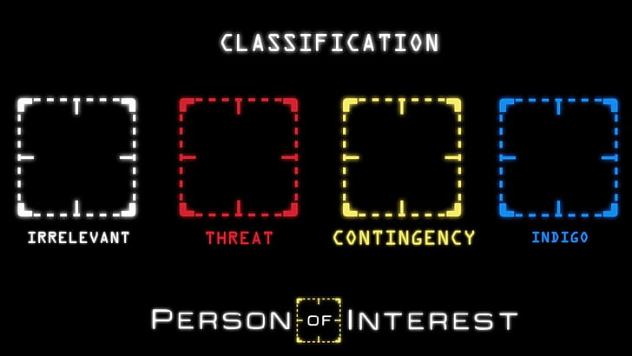
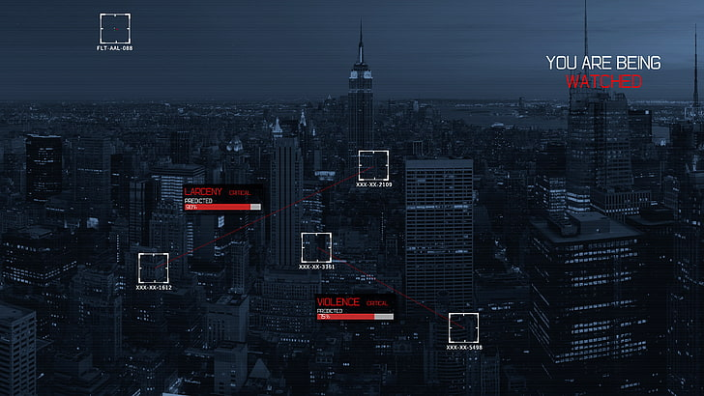

Can really deep learning help in this field?
ANSWER IS: YES
Image sources: https://www.wallpaperflare.com/action-crime-drama-interest-mystery-person-series-wallpaper-bxvuu
https://www.wallpaperflare.com/black-and-gray-city-buildings-person-of-interest-new-york-city-wallpaper-sqbgk

Slide 4
INTRODUCTION
We all know what a crime is, don’t we?
With increasing population and crime rate it takes more than manual work to contain crimes
Analyzing and predicting the crime gives more insights helps the government agents to fight crime
Deep learning is used to predict crime and help in response deployment. It is also used in cyber security

Slide 5
1.Definition of case study, problem that exists and the need of deep learning, AI
Crime prevention is an important aspect to protect public safety and national security
The problem with crime prevention is that crime is happening on a large scale and it becomes impossible to deal with it using human forces
Hence human beings need the assistance and insights from usage of machines and technologies and therefore deep learning and AI are used in this field.
This case study explains the need of deep learning can be used in crime prevention, assisting crime investigation and helping response deployment for crime hotspot areas
It also helps in cyber security in preventing hackers and terrorists from cyber attacks

Slide 6
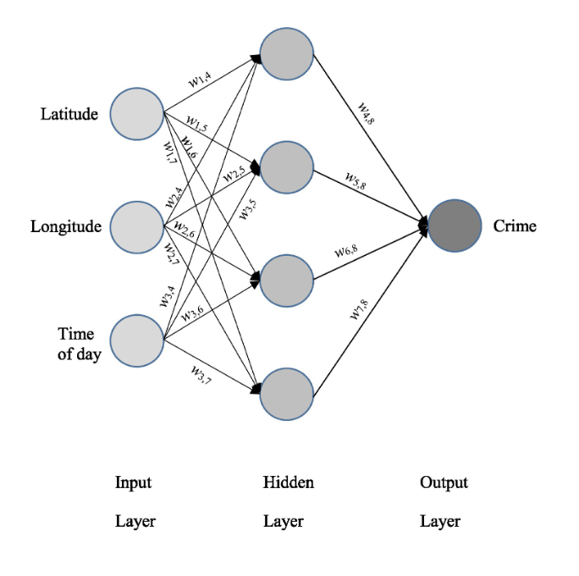
NECESSITY OF DEEP LEARNING IN CRIME PREVENTION AND CYBER SECURITY
Neural network example of crime hotspot detection
Crime prevention cannot be fully taken on by human resources as it will be similar to searching a key in the dark
The necessity of deep learning in this field comes into action while predicting how likely an offender will repeat the crime or identifying a criminal using image detection.
It is also used in assisting police investigation in decision making
Also used in crime hotspot detection
Deep learning helps in categorising tips from emergency calls into possible crimes and helping the agents to respond to an unknown crime
Deep learning is also used in cyber security for Intrusion detection and prevention systems, dealing with malware, spam and social engineering detection, network traffic analysis, user behaviour analytics.

Slide 7
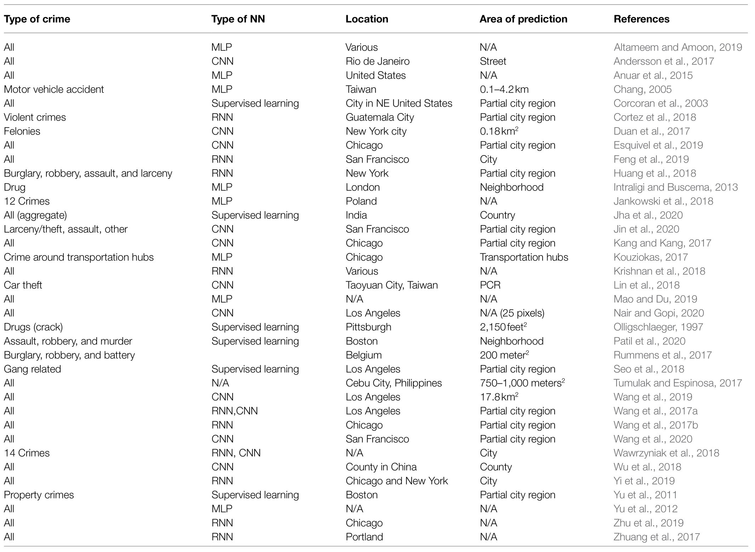
2.PATTERN RECOGNISTION AND WHY IT IS NOT ENOUGH
Example for Pattern detection for crime hotspot detection
Pattern recognistion is a method that uses machine learning algorithm to find any pattern in the data to provide useful insights
It can be used for finger print analysis etc
Pattern recognition is used for recognising patterns of crime happening in specific areas using latitude and longitude data which helps in declaring crime hotspot areas
But it is not enough when it comes to image detection and potential crime prevention as it only provides insights.
It may act as a step in crime prevention but not an adeqaute full solution.

Slide 8
3. Description of what machine learning is and how it could help on solves and Prevents from Cyber crimes and why it is not sufficient, and we need Deep Learning and AI to work with it.
What is Machine Learning?
A subfield of artificial intelligence (AI) and computer science called machine learning focuses on using data and algorithms to simulate how humans learn, gradually increasing the accuracy of the system.
How Machine Learning could help on solves and Prevents from Cyber crimes?
Machine learning is a subset of artificial intelligence that uses algorithms derived from previous data sets and statistical analysis to make assumptions about computer behavior. The computer can then adjust its behavior and even perform unprogrammed functions. These capabilities have made machine learning an important cybersecurity asset. .
Detecting Threats.
Prediction.
Example - Antivirus

Slide 9
Challenges for Machine learning in cyber crime
1. Increasing number of connections.
2. Machine learning data requirements.
3. Technical talent shortages
85 million technically skilled jobs are expected to go vacant by 2030.

Slide 10
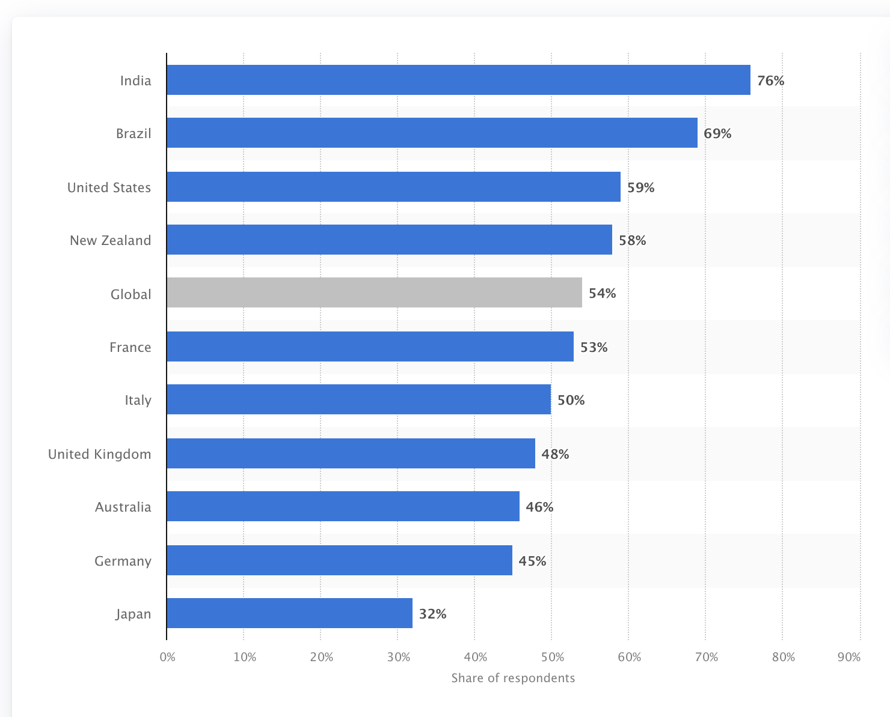
Percentage of internet users in selected countries who have ever experienced any cyber crime from November to December 2021

Slide 11

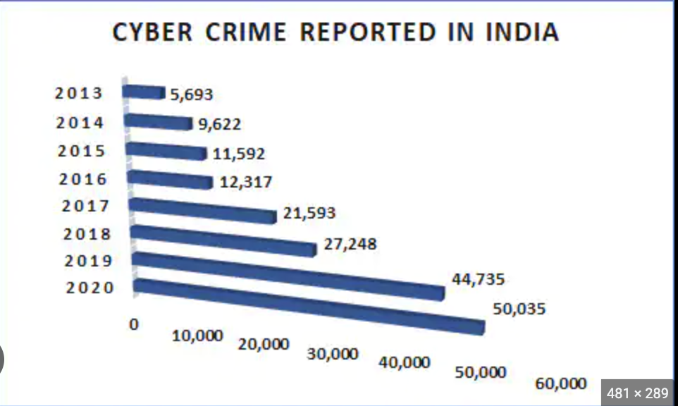

Slide 12
Significance of Deep Learning and AI in preventing Cybercrime:
AI can stop small Ransomware behaviors before it gets into the system.
During High attack we can find the behaviour of malware.
NLP in AI is used to collect imformation from of everywhere and make better
AL Help in cyber security - credit card fraud detection, Spam filter, Secure user authentication, Hacking incident forecasting.

Slide 13
4. Reason why Deep learning is more sufficient in achieving solution to prevent crimes and cyber Security?
Ability to proactively detect and stop attacks before they occur.
Ability to analyse behaviour and patern of malware.
Spam filter and Traffic Analysis of Network.
Detect user behavior, Monitor Emails

Slide 14
5 .Describe briefly: Multi-Layer Perceptron, Deep Neural Networks and Recurrent Neural Networks.
What are their similarities and differences?
What are their advantages and disadvantages?

Slide 15

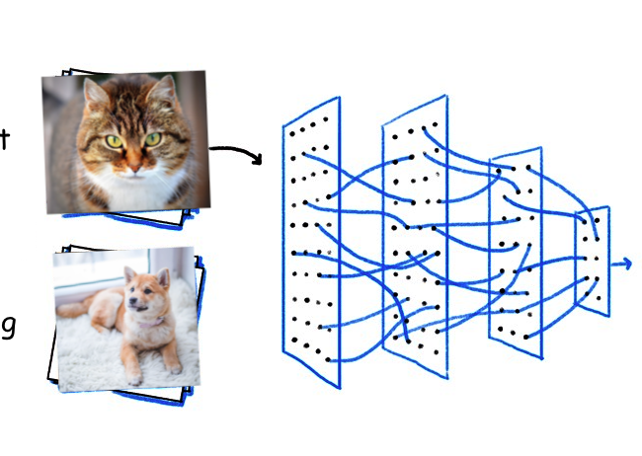

Artificial Neural Networks
Machine learning models - inspired by the structure and function of the human brain.
Applied in various applications including:

Slide 16
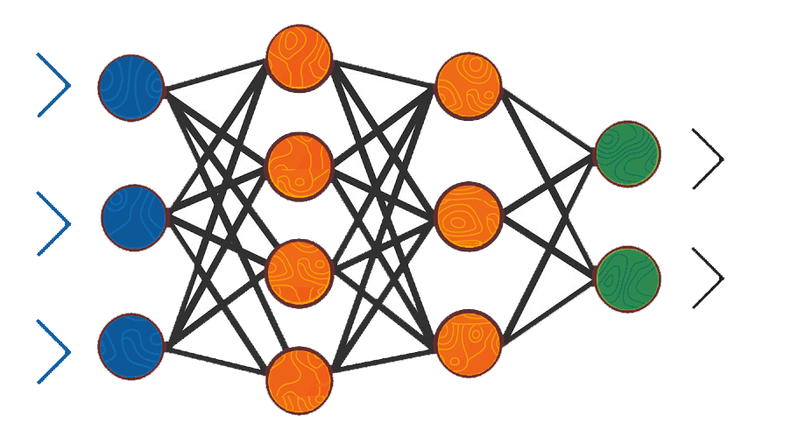
Multi-Layer Perceptron (MLP)
Multiple layers of artificial neurons.
Output of one layer serves as the input to the next layer.
Used for binary classification, multiclass classification and regression problems.
Key feature: Capable of learning non-linear relationships between inputs and outputs.

Slide 17

Deep Neural Networks (DNNs)
A type of MLP with many hidden layers, hence the name - “Deep”
Perform better than traditional MLPs for various applications including the ones mentioned previously; image classification, speech recognition and natural language processing.
Key feature: Can learn hierarchical representations of data - Lower layers learn simple features and higher layers lean more complex features.

Slide 18
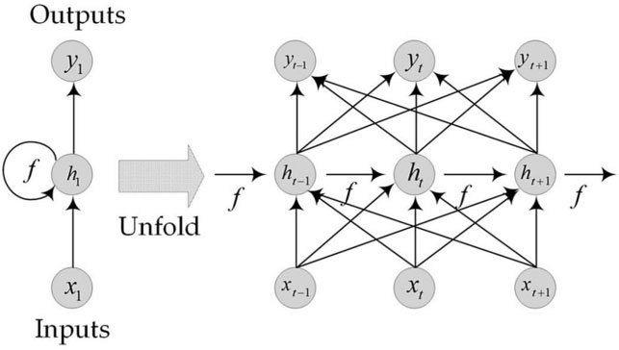
Recurrent Neural Networks (RNNs)
Type of neural network that can handle sequential data.
Time-Series Data, Speech Signals, Text Data
Recurrent connection: The output of a hidden state at time t is fed back as input to the hidden state at time t + 1.
Why? In order to maintain information from previous time steps and use it to make predictions for future time steps.
Key feature: Language translation, speech recognition, etc.

Slide 19

Similarities
Capable of learning complex relationships between inputs and outputs.
They all use gradient-based optimization to update their weights.
For various applications: Image classification, speech recognition, and natural language processing.

Slide 20

Differences
Limited to feedforward connections.
DNNs can handle more complex relationships between inputs and outputs - Due to the presence of many hidden layers.
RNNs are designed to handle sequential data and maintain information from previous time steps.

Slide 21

Advantages
Handle non-linear relationships between inputs and outputs.
Ability to learn hierarchical representations of data.
Ability to perform well for various applications.

Slide 22
Disadvantages
The need of large amount of labeled training data.
Difficulty in interpretability.
Potential for overfitting.

Slide 23
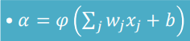
6.Describe the key equation of neural networks and what is the functionality of each element of it.
The weights are used to adjust the influence of each input on the output of the neuron.
The bias is a constant value that is added to the weighted sum of inputs and is used to adjust overall output of the neuron.
The non-linear activation allows to learn complex relationships between inputs and outputs.
the inputs to the unit.
the weights.
the bias.
the nonlinear activation function.
the unit’s activation.

Slide 24
7. Describe Convolutional Neural Networks (CNNs) and what they offer versus Neural Networks.
Convolutional Neural Networks are multi-layer neural networks used for image recognition, object detection, image classification and face recognition.
CNN consist of 3 layers;
Convolutional layer,
Pooling layer
Output layer.

Slide 25
Convolutional layer
Convolutional layer
CL makes a set of filters of learnable filters used to detect a pattern present in an image (input). CL uses matrix
Filter is slided across the width and height of input file
The process of increasing the step size by which you slide a filter over and input image is called stride.
Increase in stride decrease the size of image causing loss of some features.
To preserve the original size of an image, a layer of zeros is added around the edges of an image to enable filter perform full convolutional on edge of pixels. This is process called padding.

Slide 26
Pooling layer
Pooling layer
A layer between convolution layers in CNN.
It reduces the amount of parameter and computation in the network.
Aims at reducing the spatial size of image as it is done independently on each depth of dimension.
The commonly applied pulling method used is max pooling.

Slide 27
Flattening
Flattening
Once the pooled featured map is obtained, it is transformed into a single column and fed to neural network for processing of output

Slide 28
Output layer
After applying multiple layers of convolution and padding, the result is output.
Convolution and pooling layers can only reduce the number of parameters from original image.
A fully connected layer is required to generate an output equal to the class we need.

Slide 29
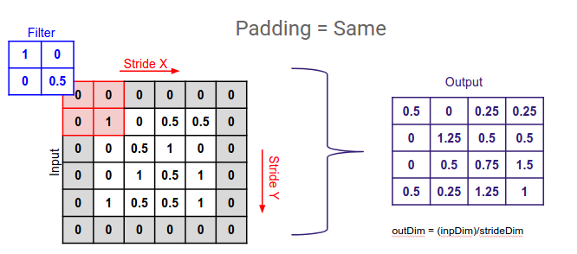
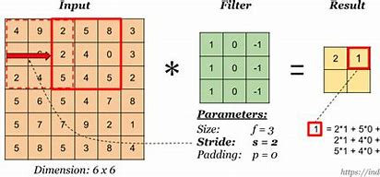
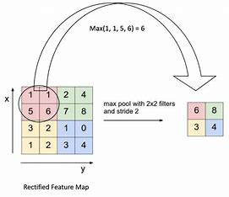


Slide 30
What CNN offers vs Neural Networks:
In neural networks, it has the ability to process temporal information a data that comes in sequence like sentences
But CNN perform better when comes to computer vision related problems
CNN has built in convolutional layers which helps to reduce the high dimensionality of an image without losing any information when it comes to image classification

Slide 31
8. Describe one of the main networks for DL (LeNet, AlexNet etc.) highlighting their characteristics and overall additional outcome they have offered to the AI.
Alex NET (2012) is a convolutional neural network used to classify and predict dataset.
Characteristics:
The model is bigger with 7 hidden layers, 650k units, 60M parameters.
Uses GPU to boost performance hence faster training
More data (106 images instead of 103 )

Slide 32
The goal of ILSVRC is to promote the development of better computer vision and deep learning.
In 2012 AlexNET competed in annual ImageNet Large scale Visual Recognition Challenge (ILSVRC). The main ideas included:
Deeper network
Stacked convolutional layers with smaller filters (+ nonlinearity)
Detailed evaluation of all components
Implementation of the ideas resulted to Improved ILSVRC top-5error rate to 6.7%.

Slide 33
CONCLUSION
Deep learning and AI are largely growing field and lot more can be done in te future as it becomes one of the best methods in all fields
Deep learning and AI helps contributes more towards crime prevention and cyber security
Human forces use the insights to prepare and respond to the attacks
Key take away would be how these techniques are used in real time

Slide 34
REFERENCES
Walczak, S (2021) ‘Predicting Crime and Other Uses of Neural Networks in Police Decision Making’, Frontiers in Psychology, Available at: https://www.frontiersin.org/articles/10.3389/fpsyg.2021.587943/full
Fichtner, E (2022) ‘5 Amazing Applications of Deep Learning in Cybersecurity’,Datto, Available at: https://www.datto.com/blog/5-amazing-applications-of-deep-learning-in-cybersecurity
Browniee, J (2019) ‘A Gentle Introduction to the ImageNet Challenge (ILSVRC)’,Machine Learning Mastery, Available at: https://machinelearningmastery.com/introduction-to-the-imagenet-large-scale-visual-recognition-challenge-ilsvrc/

